Slide 1
Figure 19.1

Slide 2
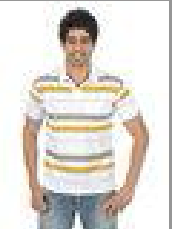
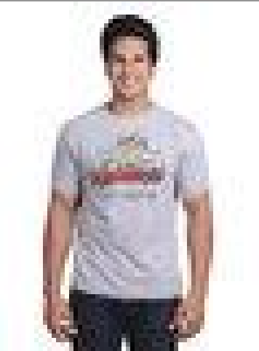
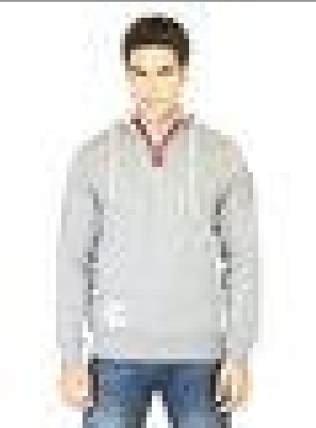
Find a stylish white T-shirt for men in the top wear category, suitable for casual wear.
Generative AI app powered by Multimodal
Score: 0.4847 Description: gender: Men, master_category: Apparel, sub_category: Topwear, article_type: Tshirts, base_colour: White, season: Fall, year: 2011, usage: Casual, productDisplayName: Classic Polo Men Vulcan White Polo Tshirts
Score: 0.4776 Description: gender: Men, master_category: Apparel, sub_category: Topwear, article_type: Tshirts, base_colour: Grey, season: Summer, year: 2011, usage: Casual, productDisplayName: Inkfruit Mens Chain Reaction T-shirt
Score: 0.4704 Description: gender: Men, master_category: Apparel, sub_category: Topwear, article_type: Sweatshirts, base_colour: Grey, season: Fall, year: 2011, usage: Sports, productDisplayName: ADIDAS Men Lfc Auth Hood Grey Sweatshirts

Slide 3
Figure 19.2

Slide 4
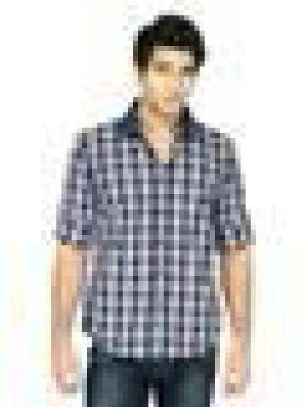
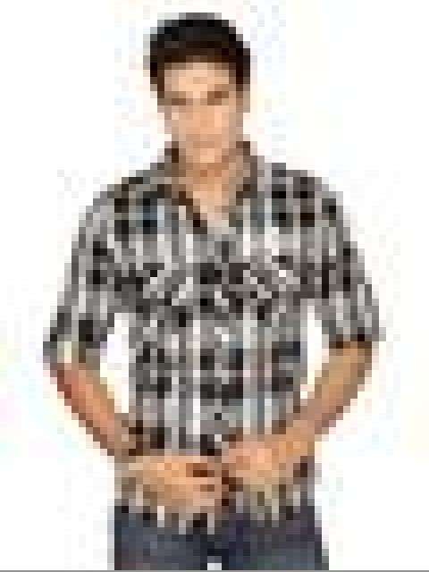
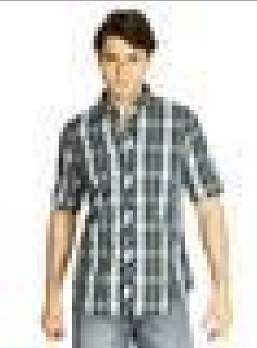
Similar picture
Generative AI app powered by Multimodal
Score: 1.0000 Description: gender: Men, master_category: Apparel, sub_category: Topwear, article_type: Shirts, base_colour: Navy Blue, season: Fall, year: 2011, usage: Casual, productDisplayName: Turtle Check Men Navy Blue Shirt
Score: 0.8251 Description: gender: Men, master_category: Apparel, sub_category: Topwear, article_type: Shirts, base_colour: Black, season: Summer, year: 2011, usage: Casual, productDisplayName: Spykar Men Black and white Check Shirt
Score: 0.8750 Description: gender: Men, master_category: Apparel, sub_category: Topwear, article_type: Shirts, base_colour: Green, season: Fall, year: 2011, usage: Casual, productDisplayName: Scullers Men Green Check Shirt

Slide 5
Figure 19.3

Slide 6
Vector DB
Description: gender: Men, master_category: Apparel, sub_category: Topwear, article_type: Tshirts, base_colour: White, season: Fall, year: 2011, usage: Casual, productDisplayName: Classic Polo Men Vulcan White Polo Tshirts
Prepare data
Create embeddings with Amazon Titan multimodal embedding model
Description: gender: Men, master_category: Apparel, sub_category: Topwear, article_type: Shirts, base_colour: Navy Blue, season: Fall, year: 2011, usage: Casual, productDisplayName: Turtle Check Men Navy Blue Shirt
raw data images with properties

Slide 7
Figure 19.4

Slide 8
Find a stylish white T-shirt for men in the top wear category, suitable for casual wear.
Convert the prompt into multimodal embedding
Similarity search
into vector DB
Retrieved relevant information
Vector DB
Text prompt
Enhanced
context
of prompt
Generate responses with generative AI model along with score

Slide 9
Figure 19.5

Slide 10
Text context
Convert the prompt into multimodal embedding
Similarity search
into vector DB
Retrieved relevant information
Vector DB
Image and text prompt
Enhanced
context
of prompt
Generate responses with generative AI model along with score

